Slide 1
Adjusted Temperature Model for Greenland
KCJ

Slide 2
Robin Temperature Model
Robin model is most valid near the ice divide. It neglects horizontal advection and strain heating. Both terms seem to contribute less than 1 K correction (Weertman and also Van der Veen). Nevertheless should check. Strain heating can be fudged by increasing basal heat flux
Camp Century (shallow Red)
NGRIP (Green)
GRIP/GISP (Deep red)
Models (black)
Parameters:
MODIS Temp
UU SMB
CISM Heat Flux
OIB ice thick
k=2.5
K=33
Using the available parameters and Robin Equation, only GISP
Model is close. Adjust SMP, Surface Temp, Heat Flux to fit all the data

Slide 3
Correction Curves
Parameter/Site | Camp C | NGRIP | GRIP
Surface Temp | 1.5 | .5 | .5
Heat Flux | 0.015 | 0.12 | 0.12
SMB | -0.06 | 0.043 | 0.017
Thickness | 0 | 0 | 0
Parameter corrections to published data (left table) tuned to fit the measured temperature profile. Parameter correction linearly interpolated between sites (below). Parameter corrections held constant past the GISP/GRIP Site (possibly can tune with mid depth cores at Milcent and Crete).

Slide 4
Original and Adjusted Parameters
CISM Heat Flux (Red) and Adjusted Flux (Blue)
OIB Thickness
CISM precip (red), RACMO SMB (green), OSU field data (red circles), adjusted SMB (Blue)
MODIS Mean Annual Temp (red) adjusted Temp (green)

Slide 5
Model Temperatures Original Input Data (OIB Thickness, UU SMB, Modis Temp), left Inputs Adjusted to Fit Borehole Temps, right
Solid Red Camp C
Dashed Red GRIP
Dashed Green NGRIP
Model Black
Discrepancy at 1500 m for NGRIP and GRIP attributed to past climate change

Slide 6
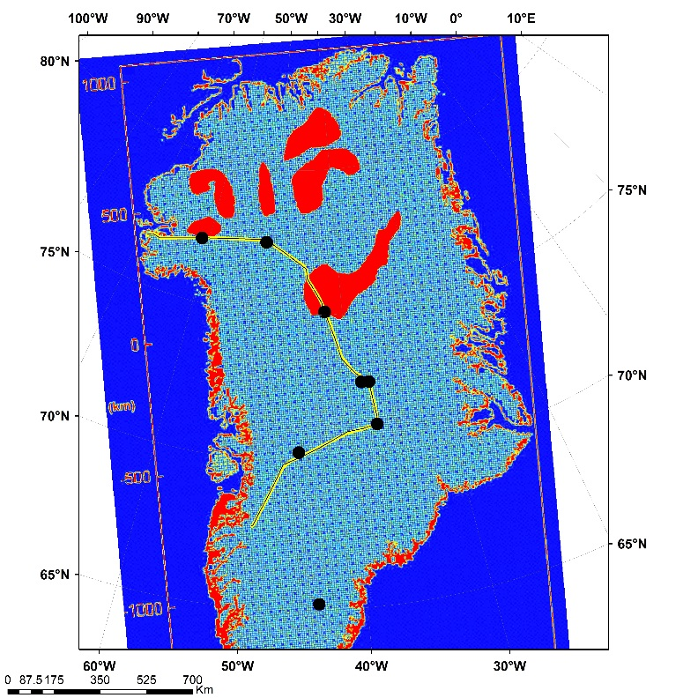
UWBRAD Spectra along Flight line: Modified Temperatures
Oswald and Gogineni, Subsurface Water Map
0.5 GHz B
1.0 R
1.4 C
2.0 G
SMOS B
1.4 GHz model forced to fit SMOS on average

Slide 7
Summary
Robin type model with the adjusted inputs can match the temperature profiles to within about 1 K except where long term climate dominates deeper part of profile.
Modern parameters not necessarily indicative of the average parameters over the 100 ka age of ice. So adjusting is reasonable and values other than heat flux are not out of line.
Adjusted temperatures yield melt temperature zone consistent with Oswald and Gogineni subglacial water map. Water turned on when basal temperature is greater than 272 K.
Measurable effect of basal water at 0.5 GHz

